Slide 1
The curse goes on and on: Thirsting for information on a sea of data
John B. Cole, PhD
PEAK Sr. VP for Research & Development
john.cole@urus.org

Slide 2
Topics for discussion
What do we want?
Why do we want it?
What have we done!?
How do we get out of this mess?

Slide 3
What do we want?
SCIENTIST
MORE DATA
DATA

Slide 4
How much data do we have now?
Type of information | Number of records
Pedigree records | 75,538,654
Animal genotypes | 5,869,403
Lactation records (since 1960) | 139,134,19
Daily yield records (since 1990) | 684,182,260
Reproductive event records | 196,505,574
Health event records | ~6,700,000
Calving difficulty scores | 27,991,336
Stillbirth scores | 18,470,886
Feed intake records | 7,708 records
Source: CDCB.

Slide 5
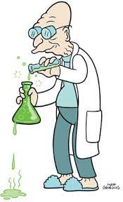
Why do we (say we) want more data?
Changes in production economics
Technology produces new phenotypes or reduces costs of collecting them
Better understanding of biology
Review by Egger-Danner et al. (2015; PMID: 25387784)

Slide 6
Why do we (really) want more data?
To solve new problems or answer new questions
To put old problems in a new light
Just in case it might be useful later
We don’t always know what to do with something until we have it
No guarantee of success

Slide 7
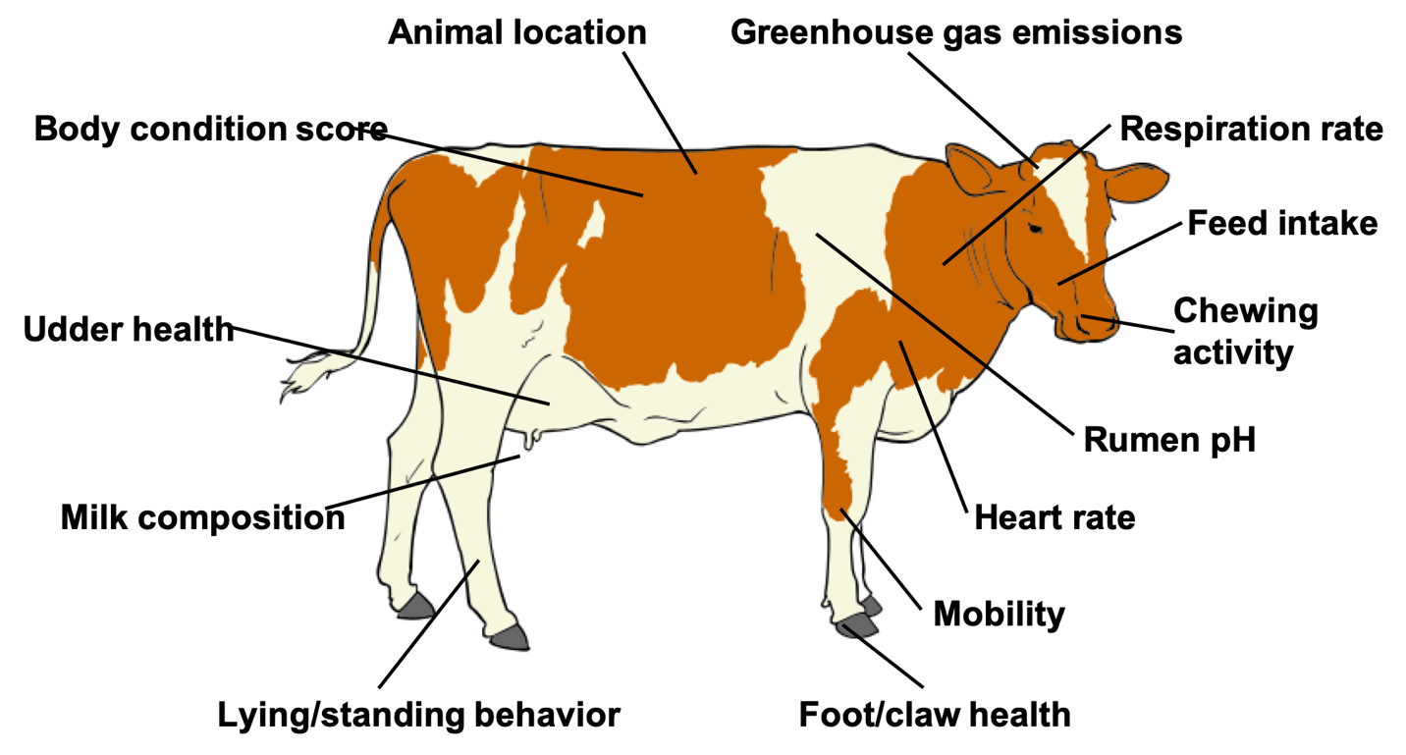
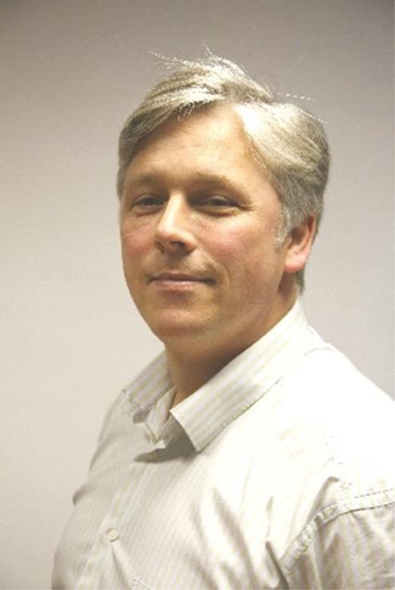
Phenotype is king!^{TM?}
Source: Cole et al. (2020; PMID: 32257602).

Slide 8
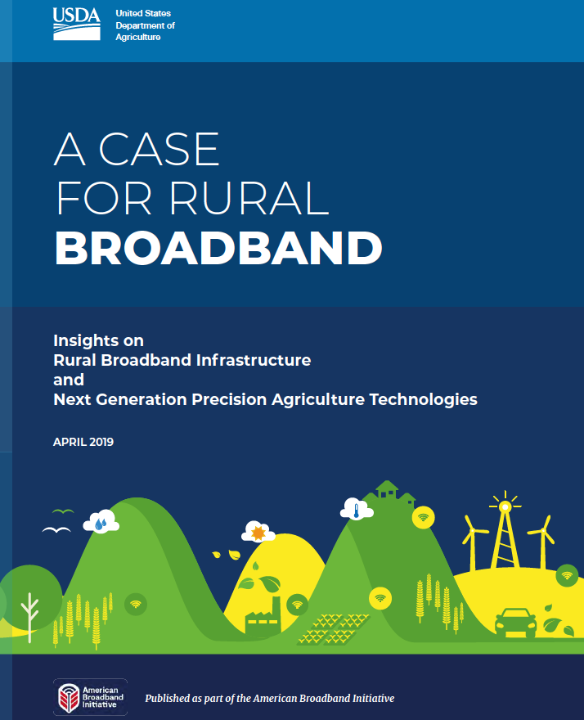
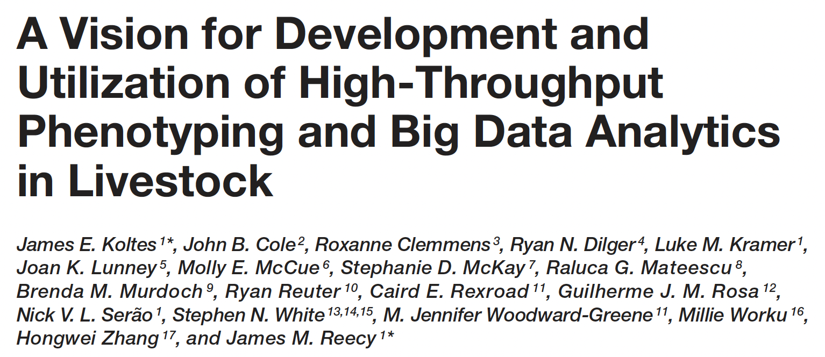
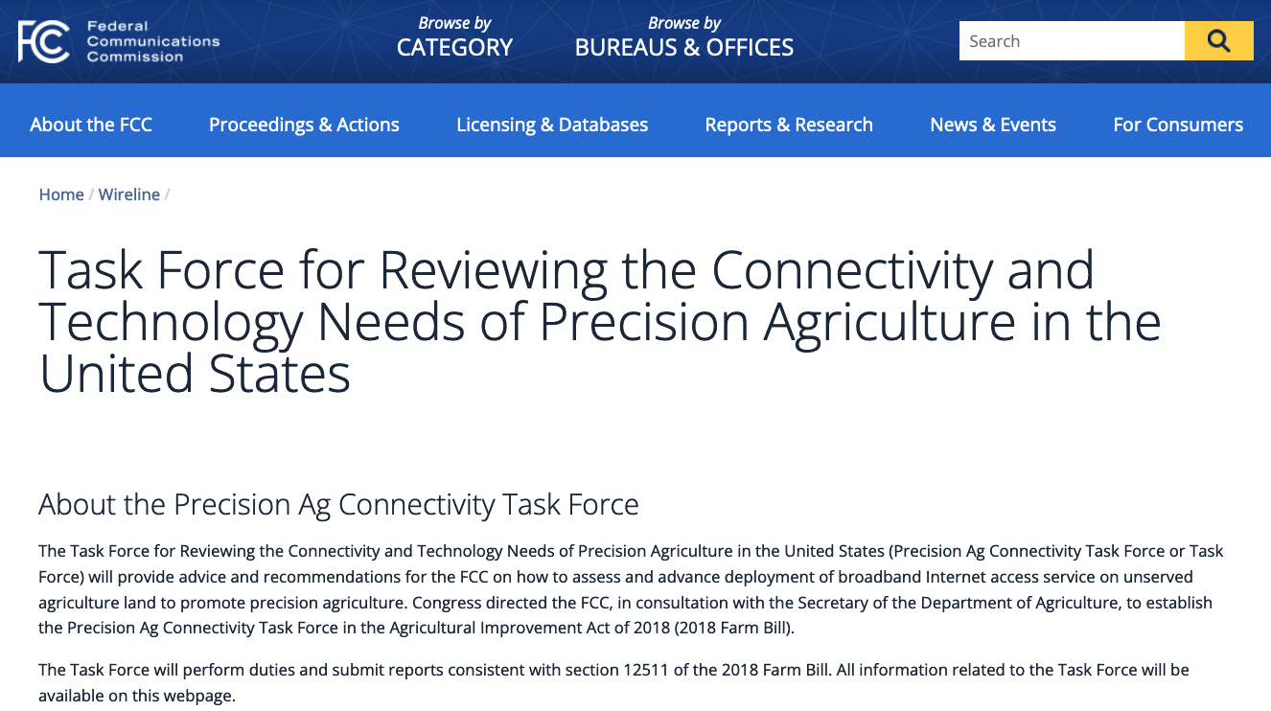
How will we get more data?

Slide 9
Is it actually going to satisfy us?
Feed Intake
Calves produced
CO₂ emission
Body size
Lifetime profit
“Efficiency”
Live weight
Functional longevity
Body condition score
Income over feed cost
Methane production
Mid-infrared milk spectrum
Microbiome

Slide 10
What do current phenotypes look like?
Low dimensionality
Usually few observations per lactation
Close correspondence of phenotypes with values measured
Easy transmission and storage
Costs of data recording are relatively low

Slide 11
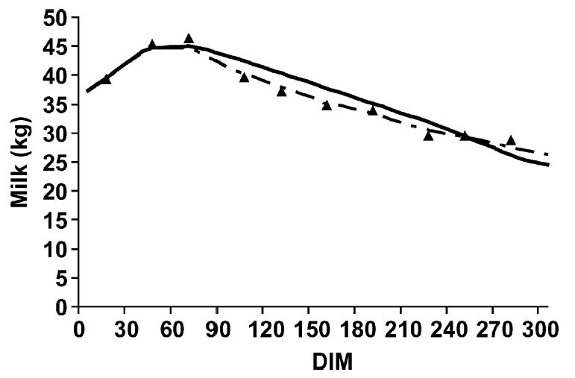
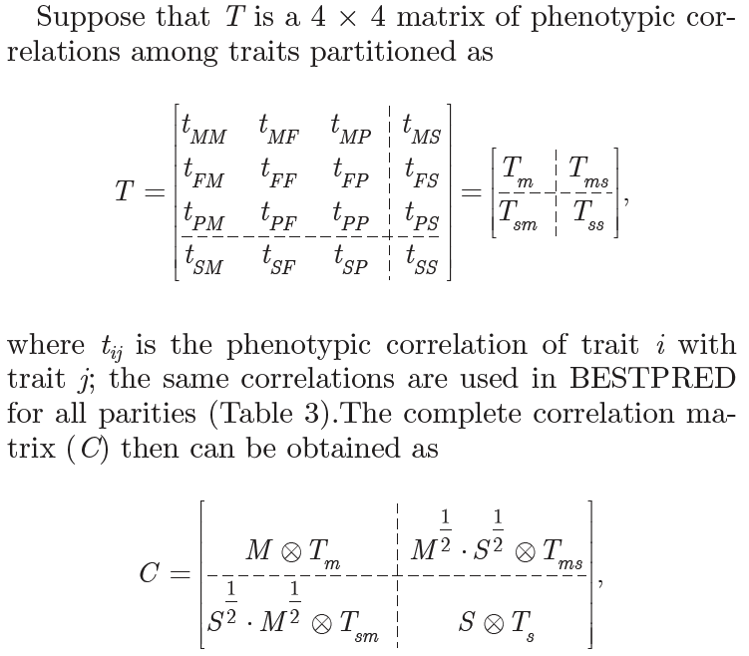
Inference is often relatively simple

Slide 12
What do new phenotypes look like?
High dimensionality
Example: MIR produces 1,060 points/observation
Disconnect between trait and measurement
More resources needed for transmission, storage, and analysis
Phenotyping costs can be high (e.g., feed intake)

Slide 13
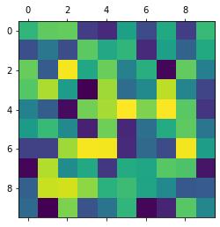
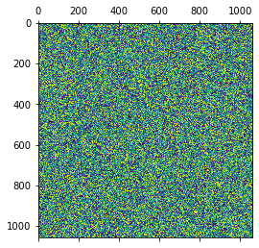
Interactions grow quadratically
Milk test day data (left): 10 samples, 45 interactions
Milk spectral data (right): 1,060 measurements, 56,179,470 interactions

Slide 14
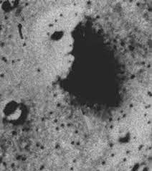
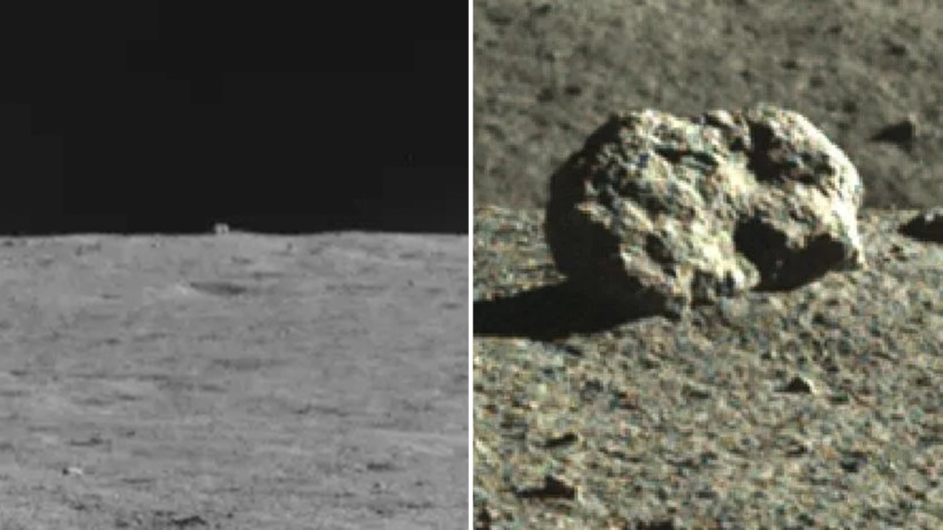
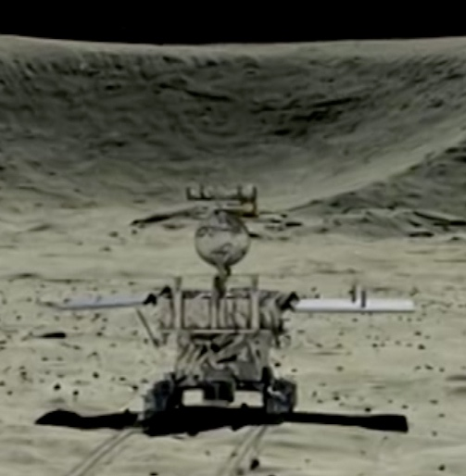
Patterns are easy, meaning is hard

Slide 15
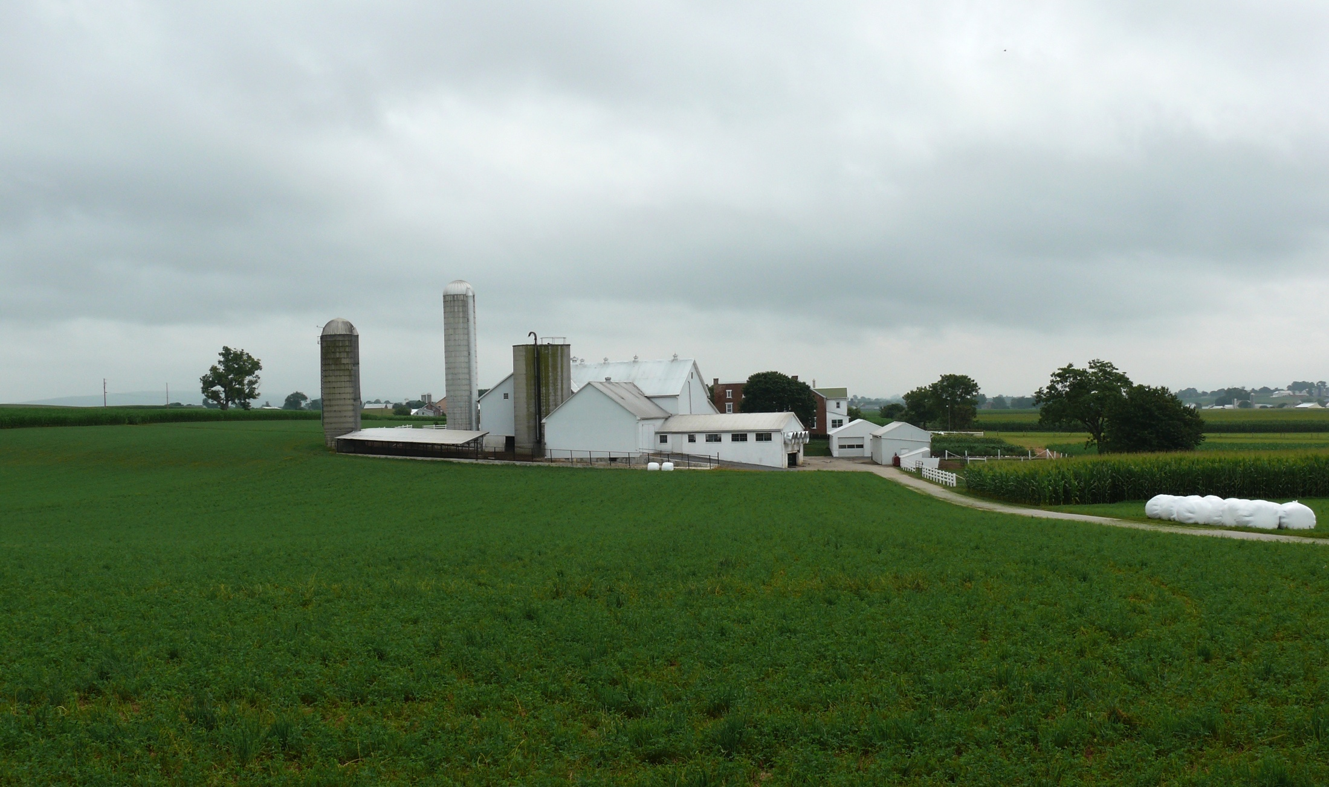
What about the outside of the cow?
Barn: Flooring type, bedding materials, density, weather data
Herdsmen/consultants: Health events, foot/claw health, veterinary treatments
Parlor: yield, composition, milking speed, conductivity, progesterone, temperature
Silo/bunker: ration composition, nutrient profiles
Pasture: soil type/composition, nutrient composition
Laboratory/milk plant: detailed milk composition, mid-infrared spectral data

Slide 16
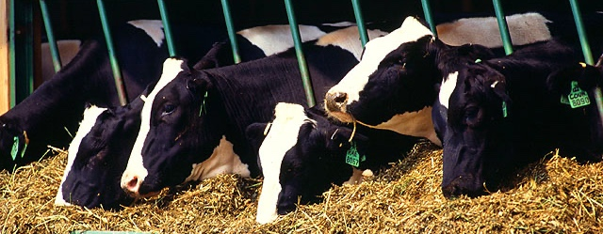
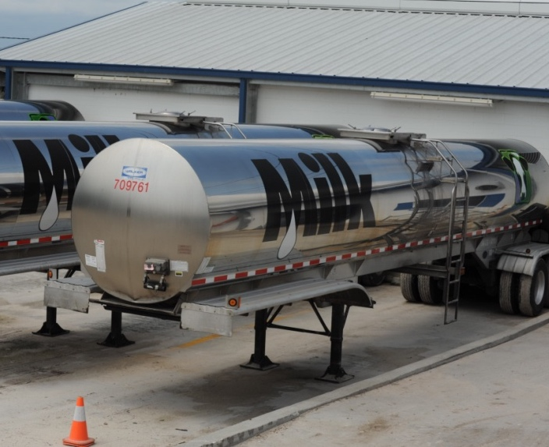
Traditional phenotyping scheme
Current milk recording
Many farms participate
Low-intensity phenotyping (few measurements per cow)
Well-suited to traits with low recording costs
Source: ARS, USDA
Source: North Florida Holsteins
Source: John B. Cole

Slide 17
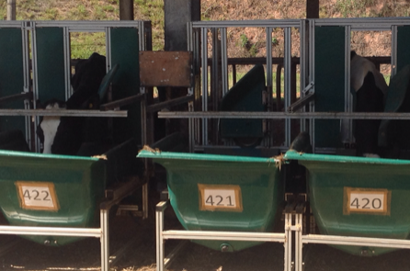
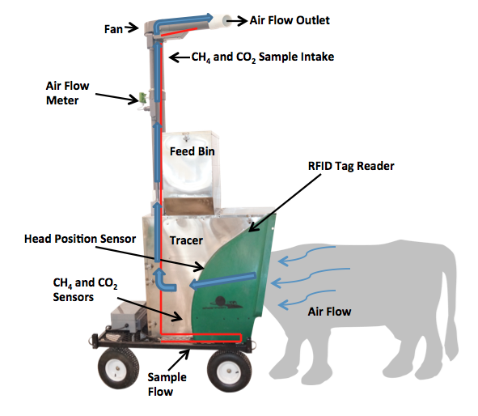
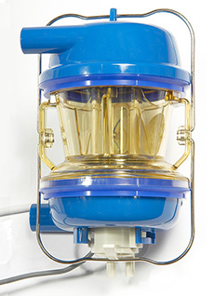
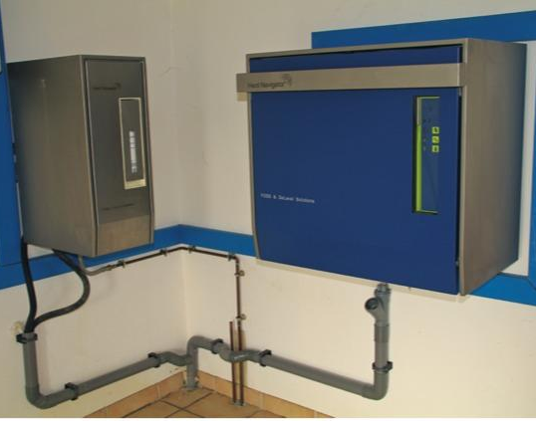
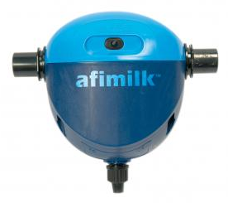
Alternative phenotyping scheme
Few farms
Intensive phenotyping
Use cases
Expensive-to-measure traits
Developing countries
Source: John B. Cole
Source: http://c-lockinc.com/
Source: http://www.afimilk.com/
Source: http://goo.gl/wu8YtR

Slide 18
High-throughput phenotyping
Source: Fahlgren et al. (2015; https://doi.org/10.1016/j.pbi.2015.02.006).

Slide 19
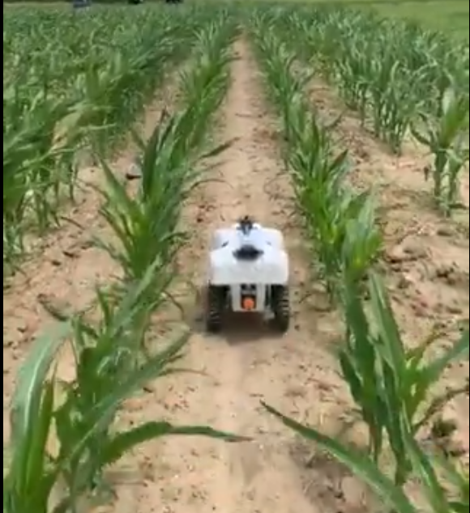
Next-generation automated phenotyping?
Source: Skaro Ministry of Science/BBC One
Source: Aimee Schulz (@aimeejschulz)

Slide 20
Do more data make prediction more difficult?
Genetic prediction
Volume of data not a problem per se
New data may need more complex models
Causal inference remains challenging, but is needed to bridge gaps
Advancements will be incremental
Phenotypic prediction
Real-time or near-real-time calculation needed
Data transfer speeds may be limiting
Information may be siloed on the farm
Collaboration is critical!

Slide 21
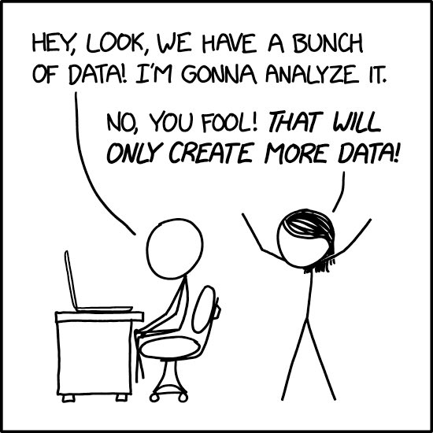
The promise of phenotype prediction
Many data now available to farmers
Underutilized for predicting future performance
Could also be used to assign animals to management groups or schedule treatments

Slide 22
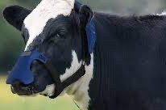
Do we know what we don’t know?
Will new technologies hold up to wear and tear in the field?
Are data networks available where they’re needed?
Can farmers get end-user support and maintenance and repair when they need it?
Does per-cow licensing scale when everyone’s doing it?
Will data be siloed?

Slide 23
Rural broadband remains a challenge
The fundamental premise of many “big data” approaches is that data can be shipped to remote computing resources, and results returned to the decision-maker
Cloud-based services depend on reliable networks with “modern” data transfer speeds
22.3 percent of rural areas lack access to 25/3 Mbps broadband, compared to only 1.5 percent of Americans in urban areas (FCC)
How gracefully do your systems degrade when the network is of poor quality?

Slide 24
Animal identification is hard
Barn numbers (“cow control numbers”) are fundamentally inadequate to the task of animal ID
They’re not unique within or across locations
Eartags with 15-byte Animal Identification Numbers (AIN) are preferred
They correspond to the 17- and 18-byte IDs used by CDCB
They comply with International Committee for Animal Recording guidelines
AIN should be used instead of cow control numbers when storing data in central repositories or sharing across data providers

Slide 25
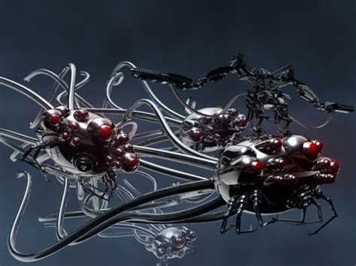
Quis custodiet ipsos custodes?
Many new tools are black boxes
Who will validate their performance?
What are the gold standards for comparison?
How “close” is close enough for decision-making?

Slide 26
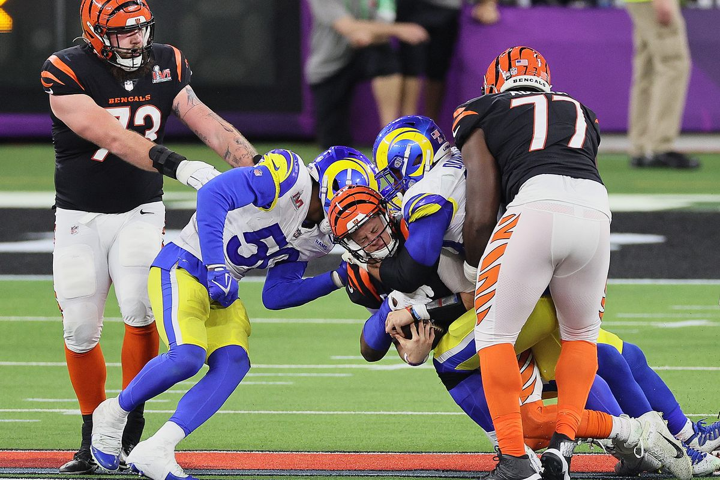
Nobody can do everything alone…
Milk recording programs are successful because lots of people are involved
Decision-making is often much slower than it should be
Technology isn’t magic, and it can’t do everything
Move fast and break things is fine for toys, not for tools

Slide 27
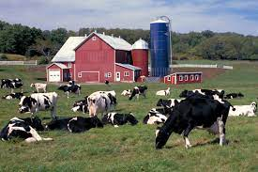
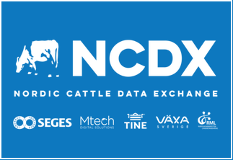
Can we get out of this mess?

Slide 28
Final thoughts
If we want farmers to invest in these new technologies then there must be a way for them to earn their money back.
Supporting national milk recording programs in the future is a challenge as farms continue to grow bigger.
We should remain focused on producing healthful food as efficiently as possible for a growing population.
New analytics technologies will support that goal, but they need validation in real-world situations.

Slide 29
Questions?

