Slide 1

National DHIA System Leadership Sessions
Session 2 - Identification
February 22, 2022
Alex Turner, DVM
Assistant Director, National Animal Disease Traceability and
Veterinary Accreditation Center
USDA/APHIS, Veterinary Services
Animal Disease Traceability
Animal ID: Today and Tomorrow

Slide 2
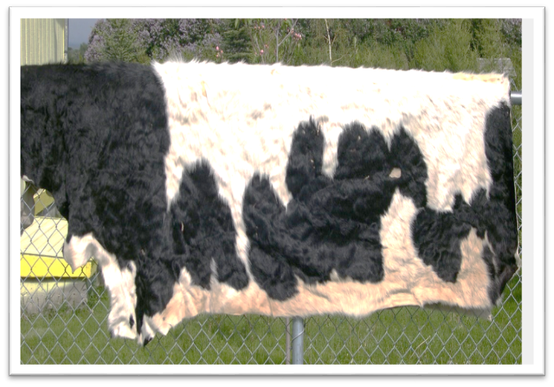
Why is ADT Important in the USA?
Protect American Livestock Agriculture
  Food Safety
  Market Values (domestic and trade)
  Foreign Animal Diseases (Zoonotic and not)
Notes:
Cattle -$66.4 billion
Dairy (production) - $35 billion
Pork - $23.4 billion
Poultry - $40 billion
Sheep/Goat - $2 billion
This is the “Cow That Stole Christmas” 12/23/03 10 years to gain OIE “negligible risk” status back. 17 years until Japan agreed to import US beef, still has age restrictions in place

Slide 3
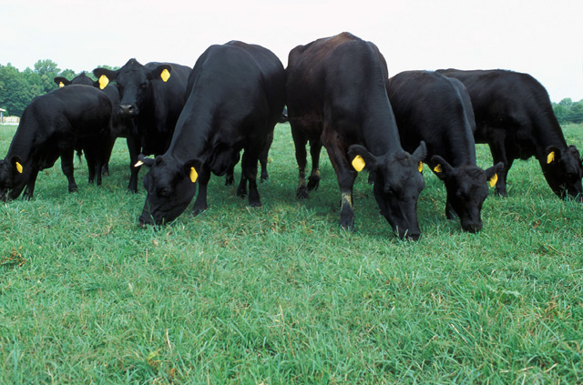
Animal Disease Traceability
Program Overarching Goals
  Increase use of electronic ID tags for Official ID
  Enhance the ability to track animals from birth to slaughter
  Advance sharing of electronic data
  Elevate discussions to work towards electronically submitted ICVIs
Notes:
As a reminder, these have been our goals dating back to 2018. We have continued to work towards these goals with different tools available:
-ADT Cooperative Agreements – $6 million/year across 46 states/territories/tribes
- (plus supplement funding for RFID readers over FY2019/2020 to the tune of $1.2 million)

Slide 4
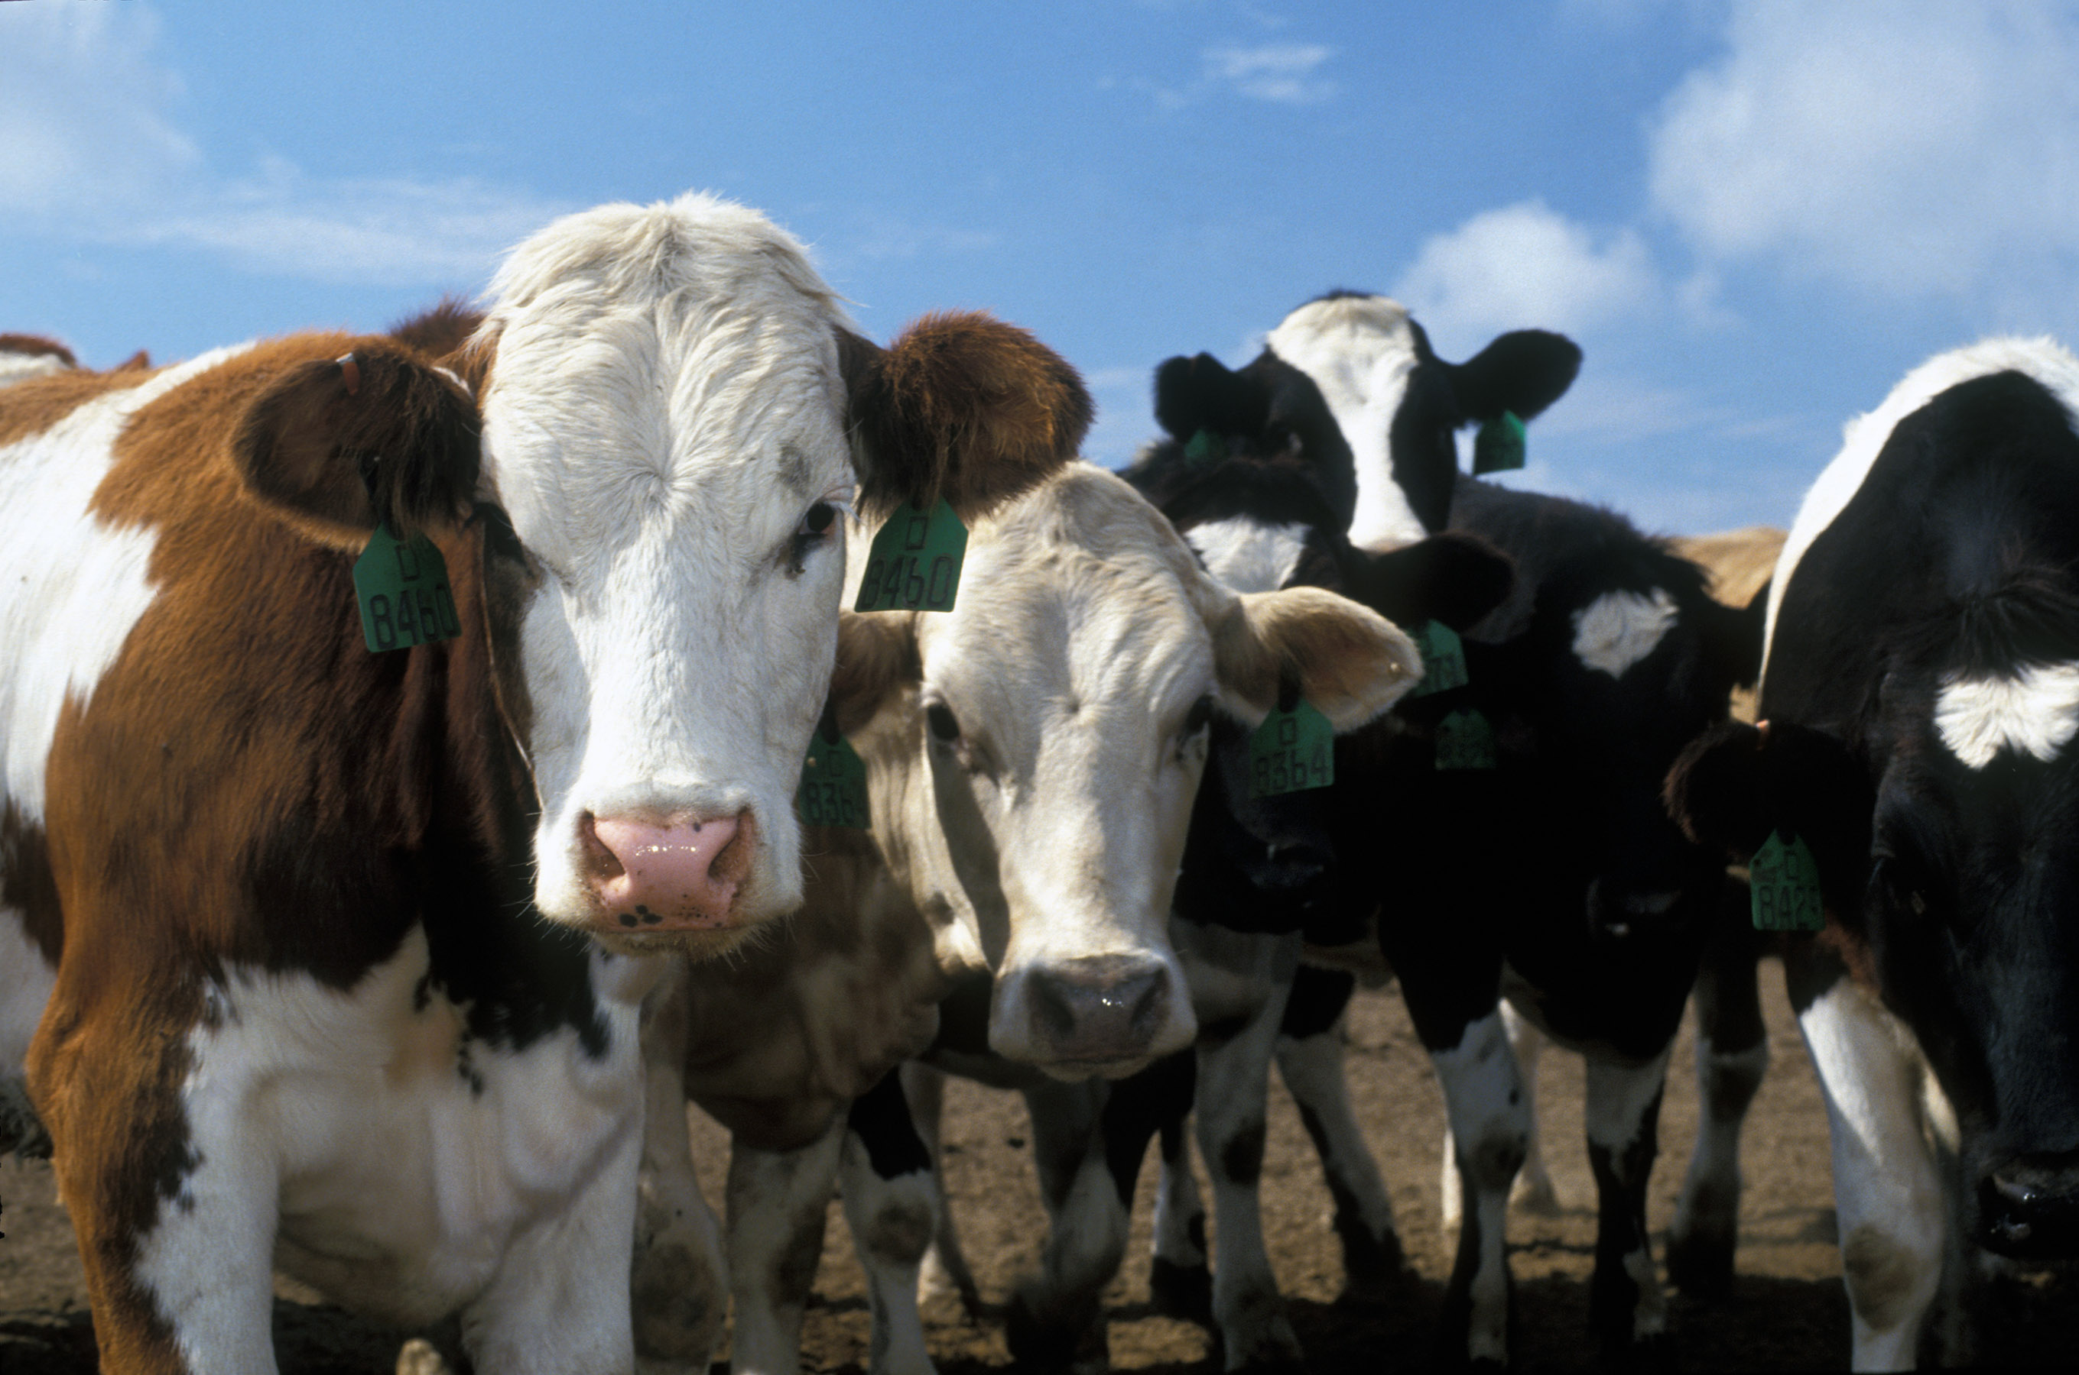
A National “Disease Insurance” Policy
ADT doesn’t prevent disease
ADT speeds the response
ADT is about proving that the healthy animals were not exposed
ADT is about returning the cattle business in the country to “normal” as soon as possible following a Foreign Animal Disease Detection

Slide 5
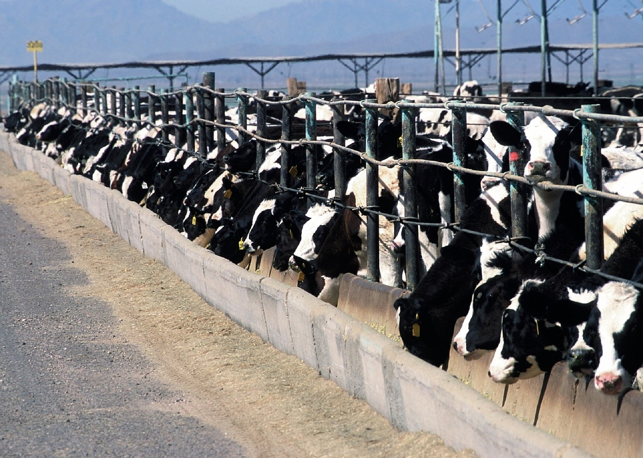
Animal ID
Used for:
  Management
  Reproduction
  Genetics
  Production
  Health
  Feeding/gain
  Movement

Slide 6
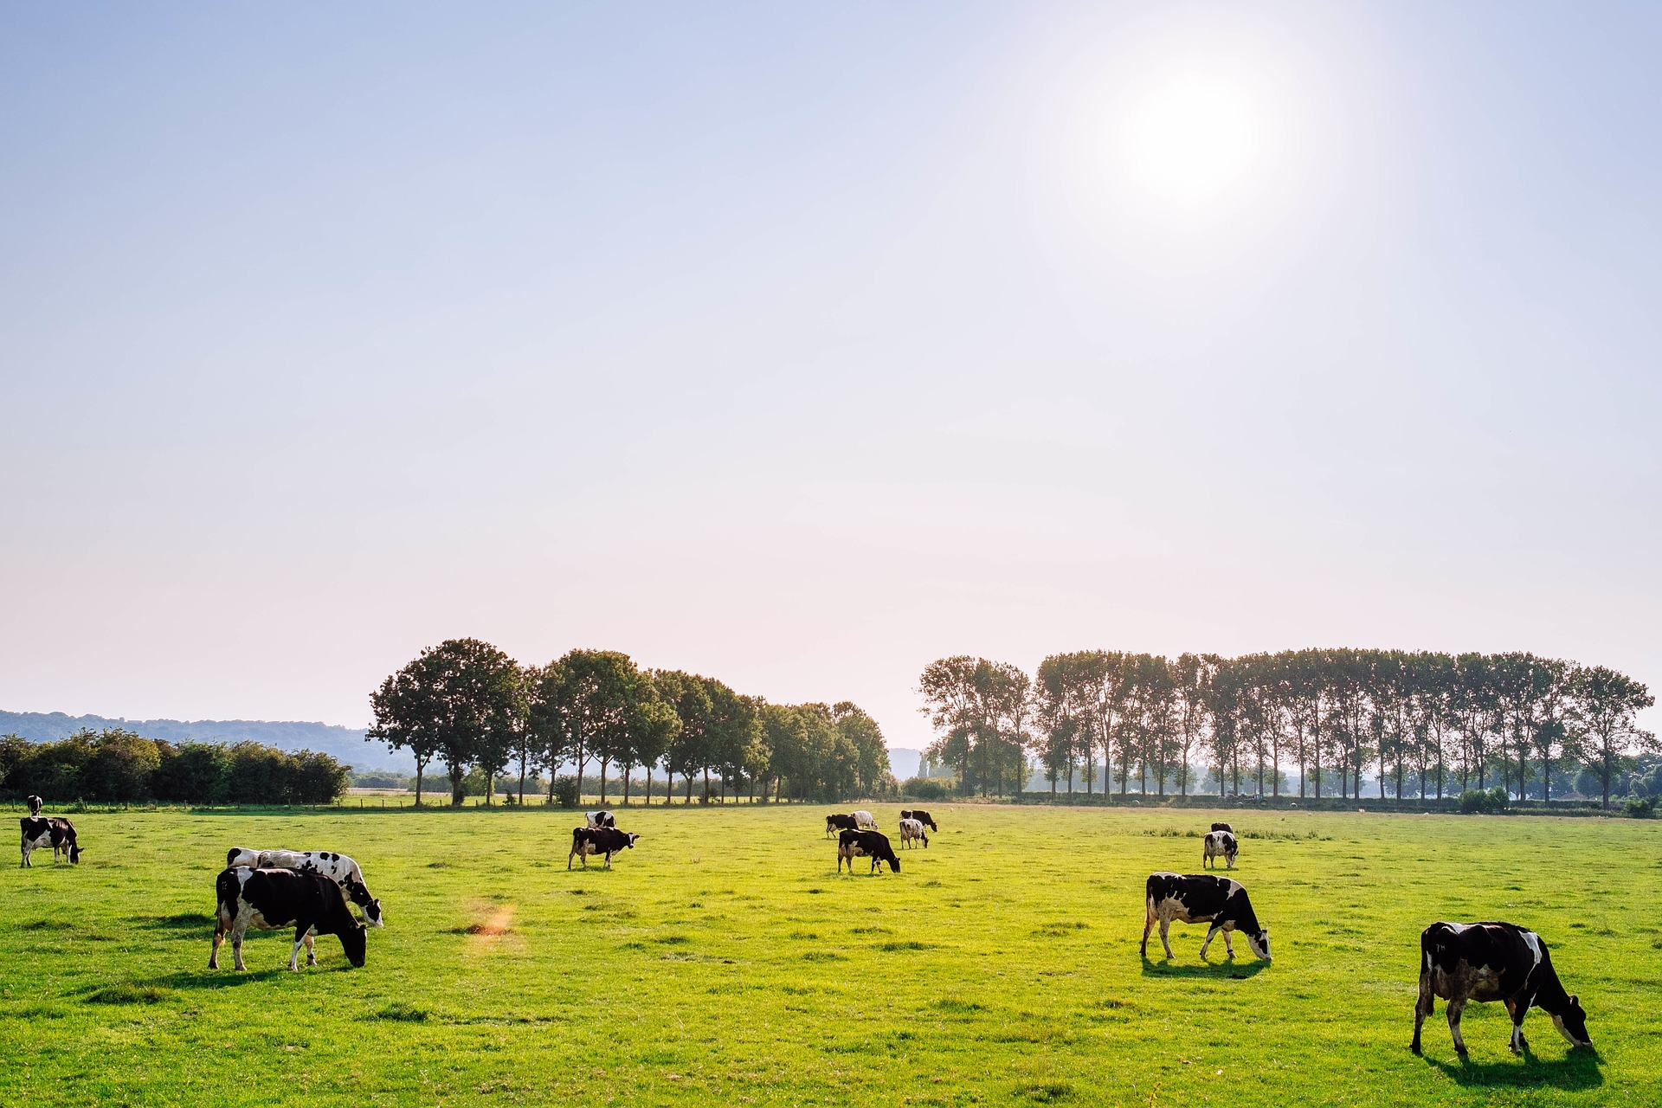
Current Official ID for Cattle
  Ear tags
    Visual only
    Electronically Readable
    Low Frequency
    Ultra High Frequency
  Tattoos
  Brands
  Backtags?

Slide 7
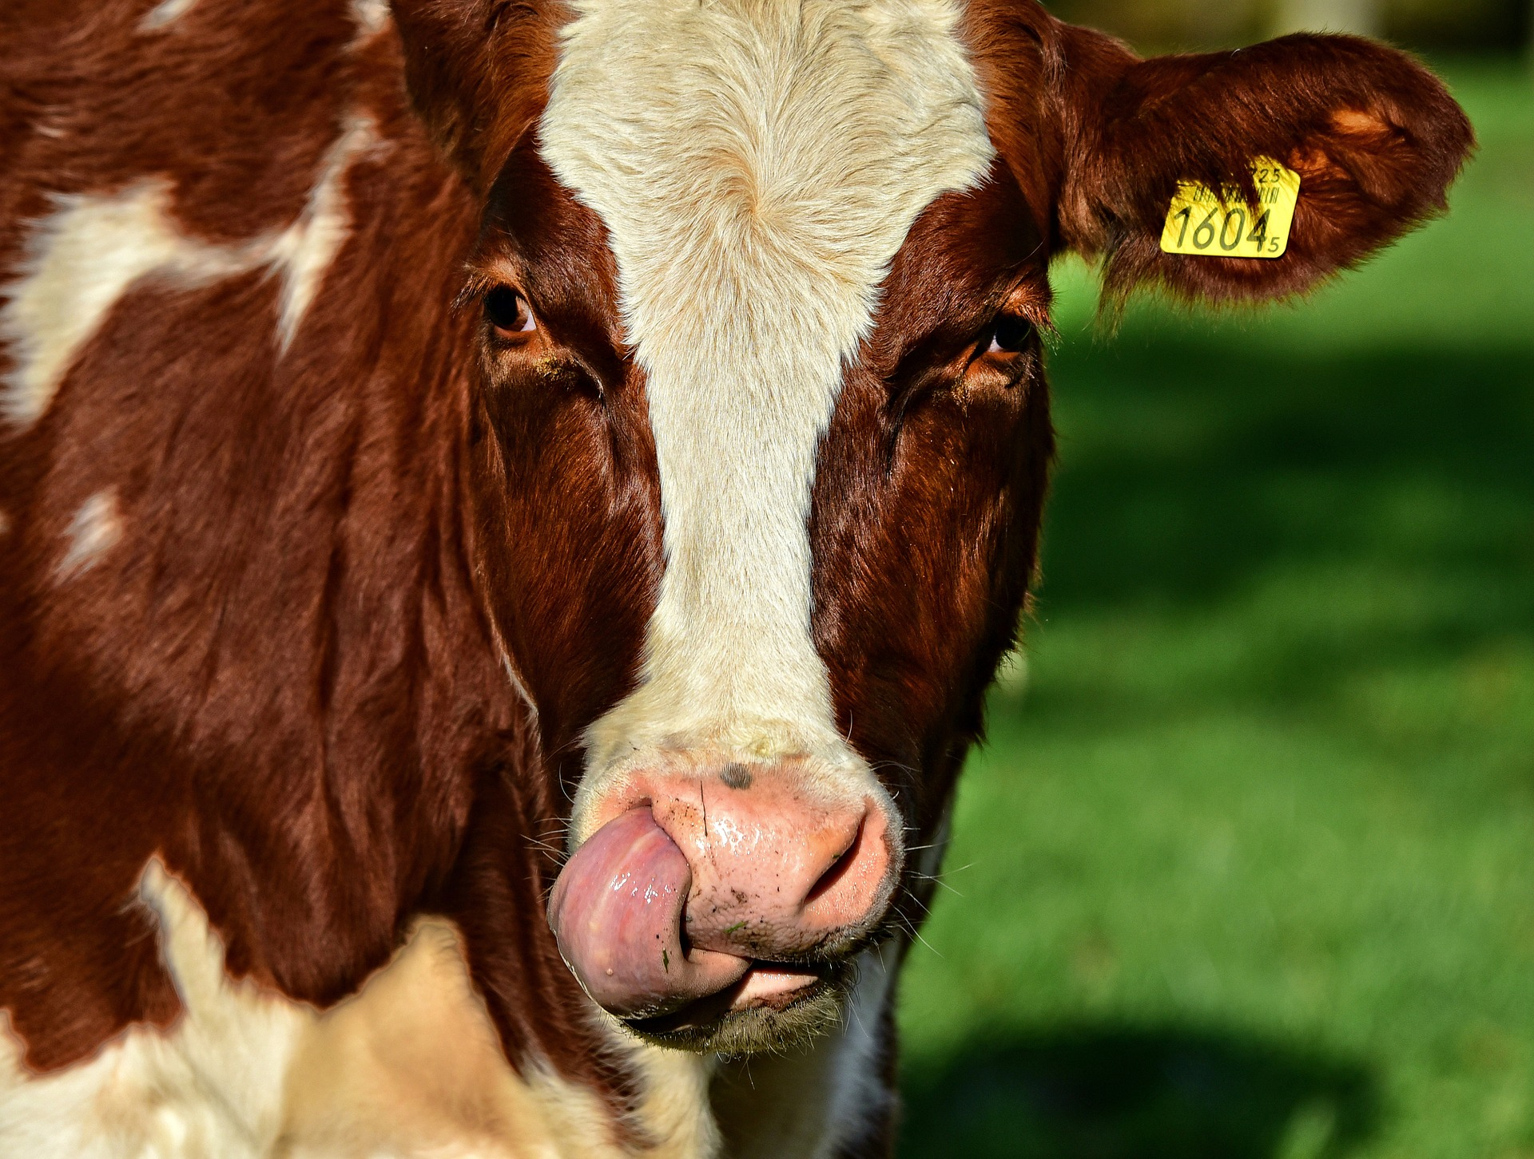
Free RFID Tag Program
Began January 30, 2020
Ordered via USDA through the State Veterinarian
10,791,000 tags shipped
7,051,600 white
3,739,400 orange
All 50 states and 2 U.S. Territories have received low frequency RFID tags in this program
Notes:
Proposed transition to RFID as Official ID in cattle/bison was first announced in April of 2019, interrupted in fall of 2019
On January 30, 2020, USDA started taking orders after discussion with SAHO WG (cost share? Direct from manufacturer? )

Slide 8
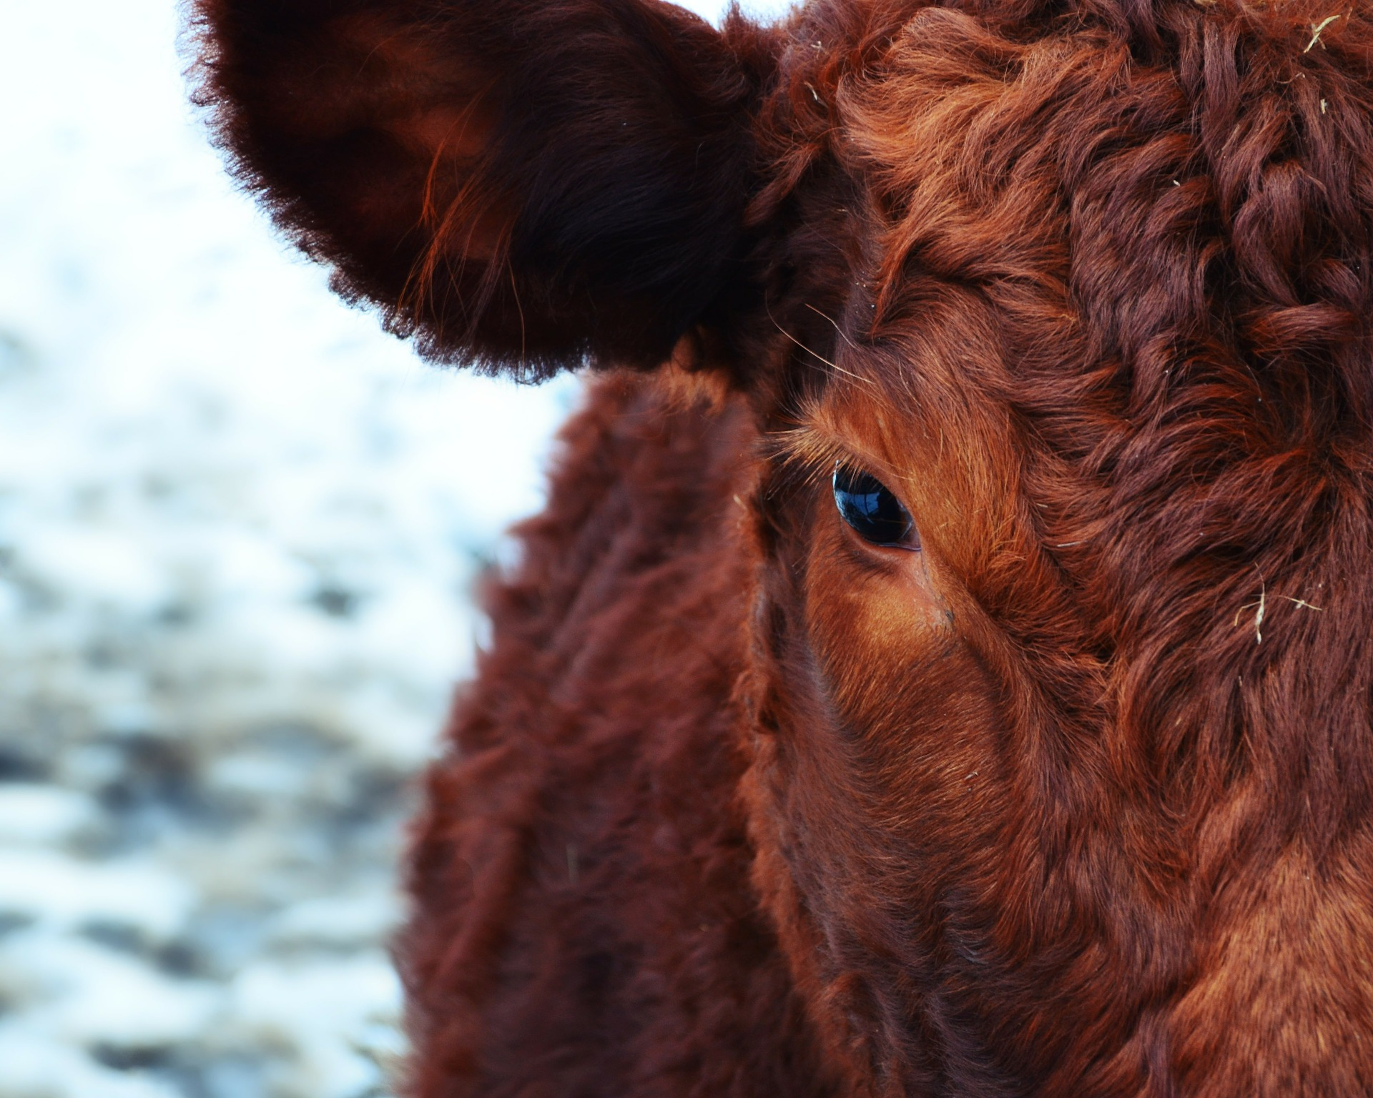
Future Program Goals
Electronically readable ID for cattle and bison
Increase use of electronic records for states and accredited vets (ICVIs)
Retrieve trace information in shortest possible time
Improve data accuracy and reduce data error rate
Let the regulatory ADT function in the background, until needed

Slide 9
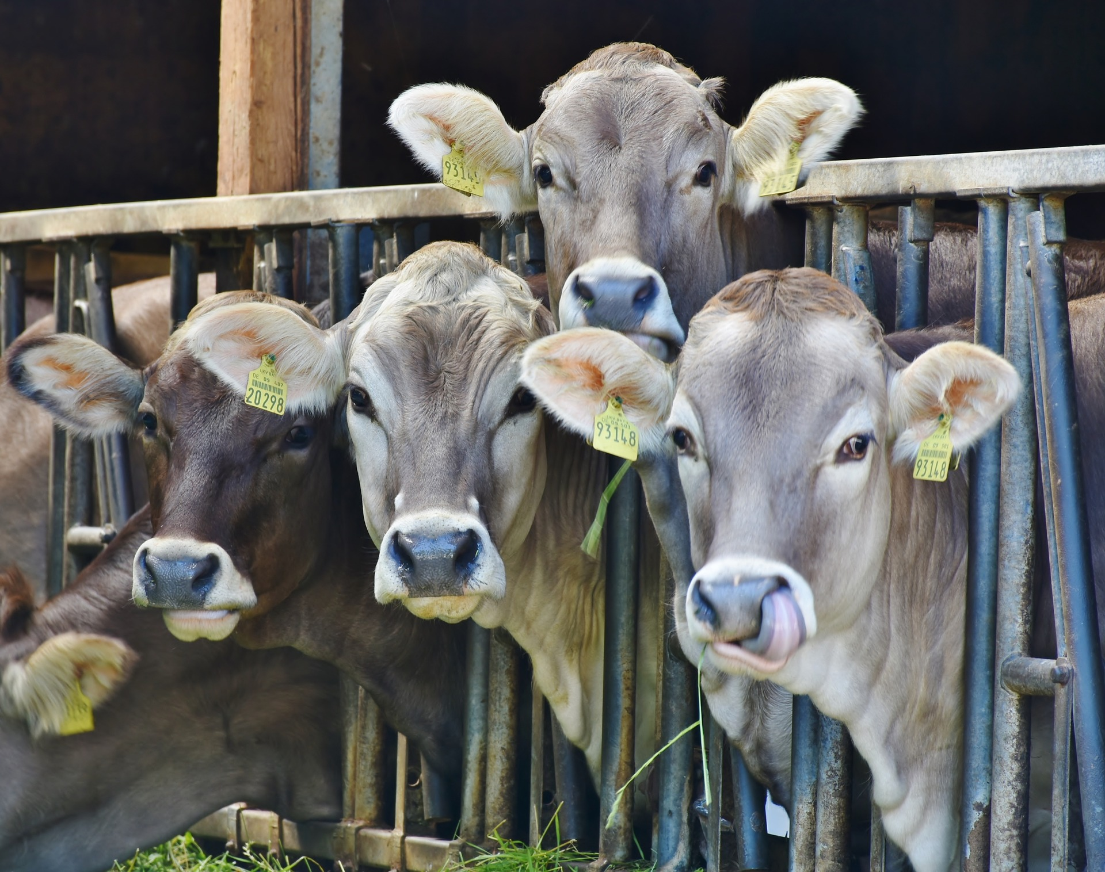
ADT Rule (9 CFR Part 86)
APHIS- Proposed Rule Stage, Sequence No. 11 is Animal Disease Traceability; Electronic Identification. (Regulation Identifier No. 0579-AE64)
Federal Register publication expected in mid 2022.
After the proposal is posted to the Federal Register a 90-day comment period will follow. The comment period is open to everyone.

Slide 10
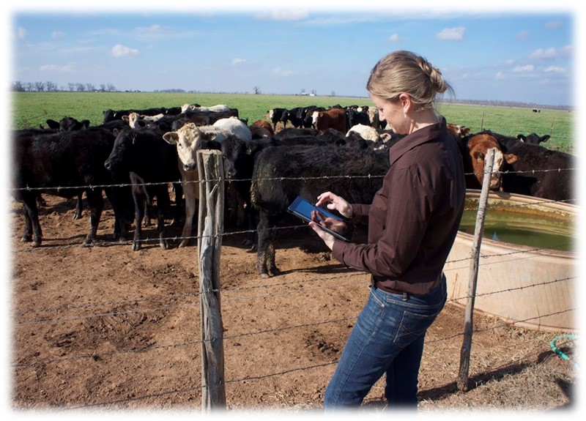
ICVI
Interstate Certificate of Veterinary Inspection
Classically called a Health Certificate
Accredited Veterinarian
Required for interstate movement in most cases
Continue to support transition to electronic options
Apps and electronic versions are not waiting for a stamp and snail mail

Slide 11
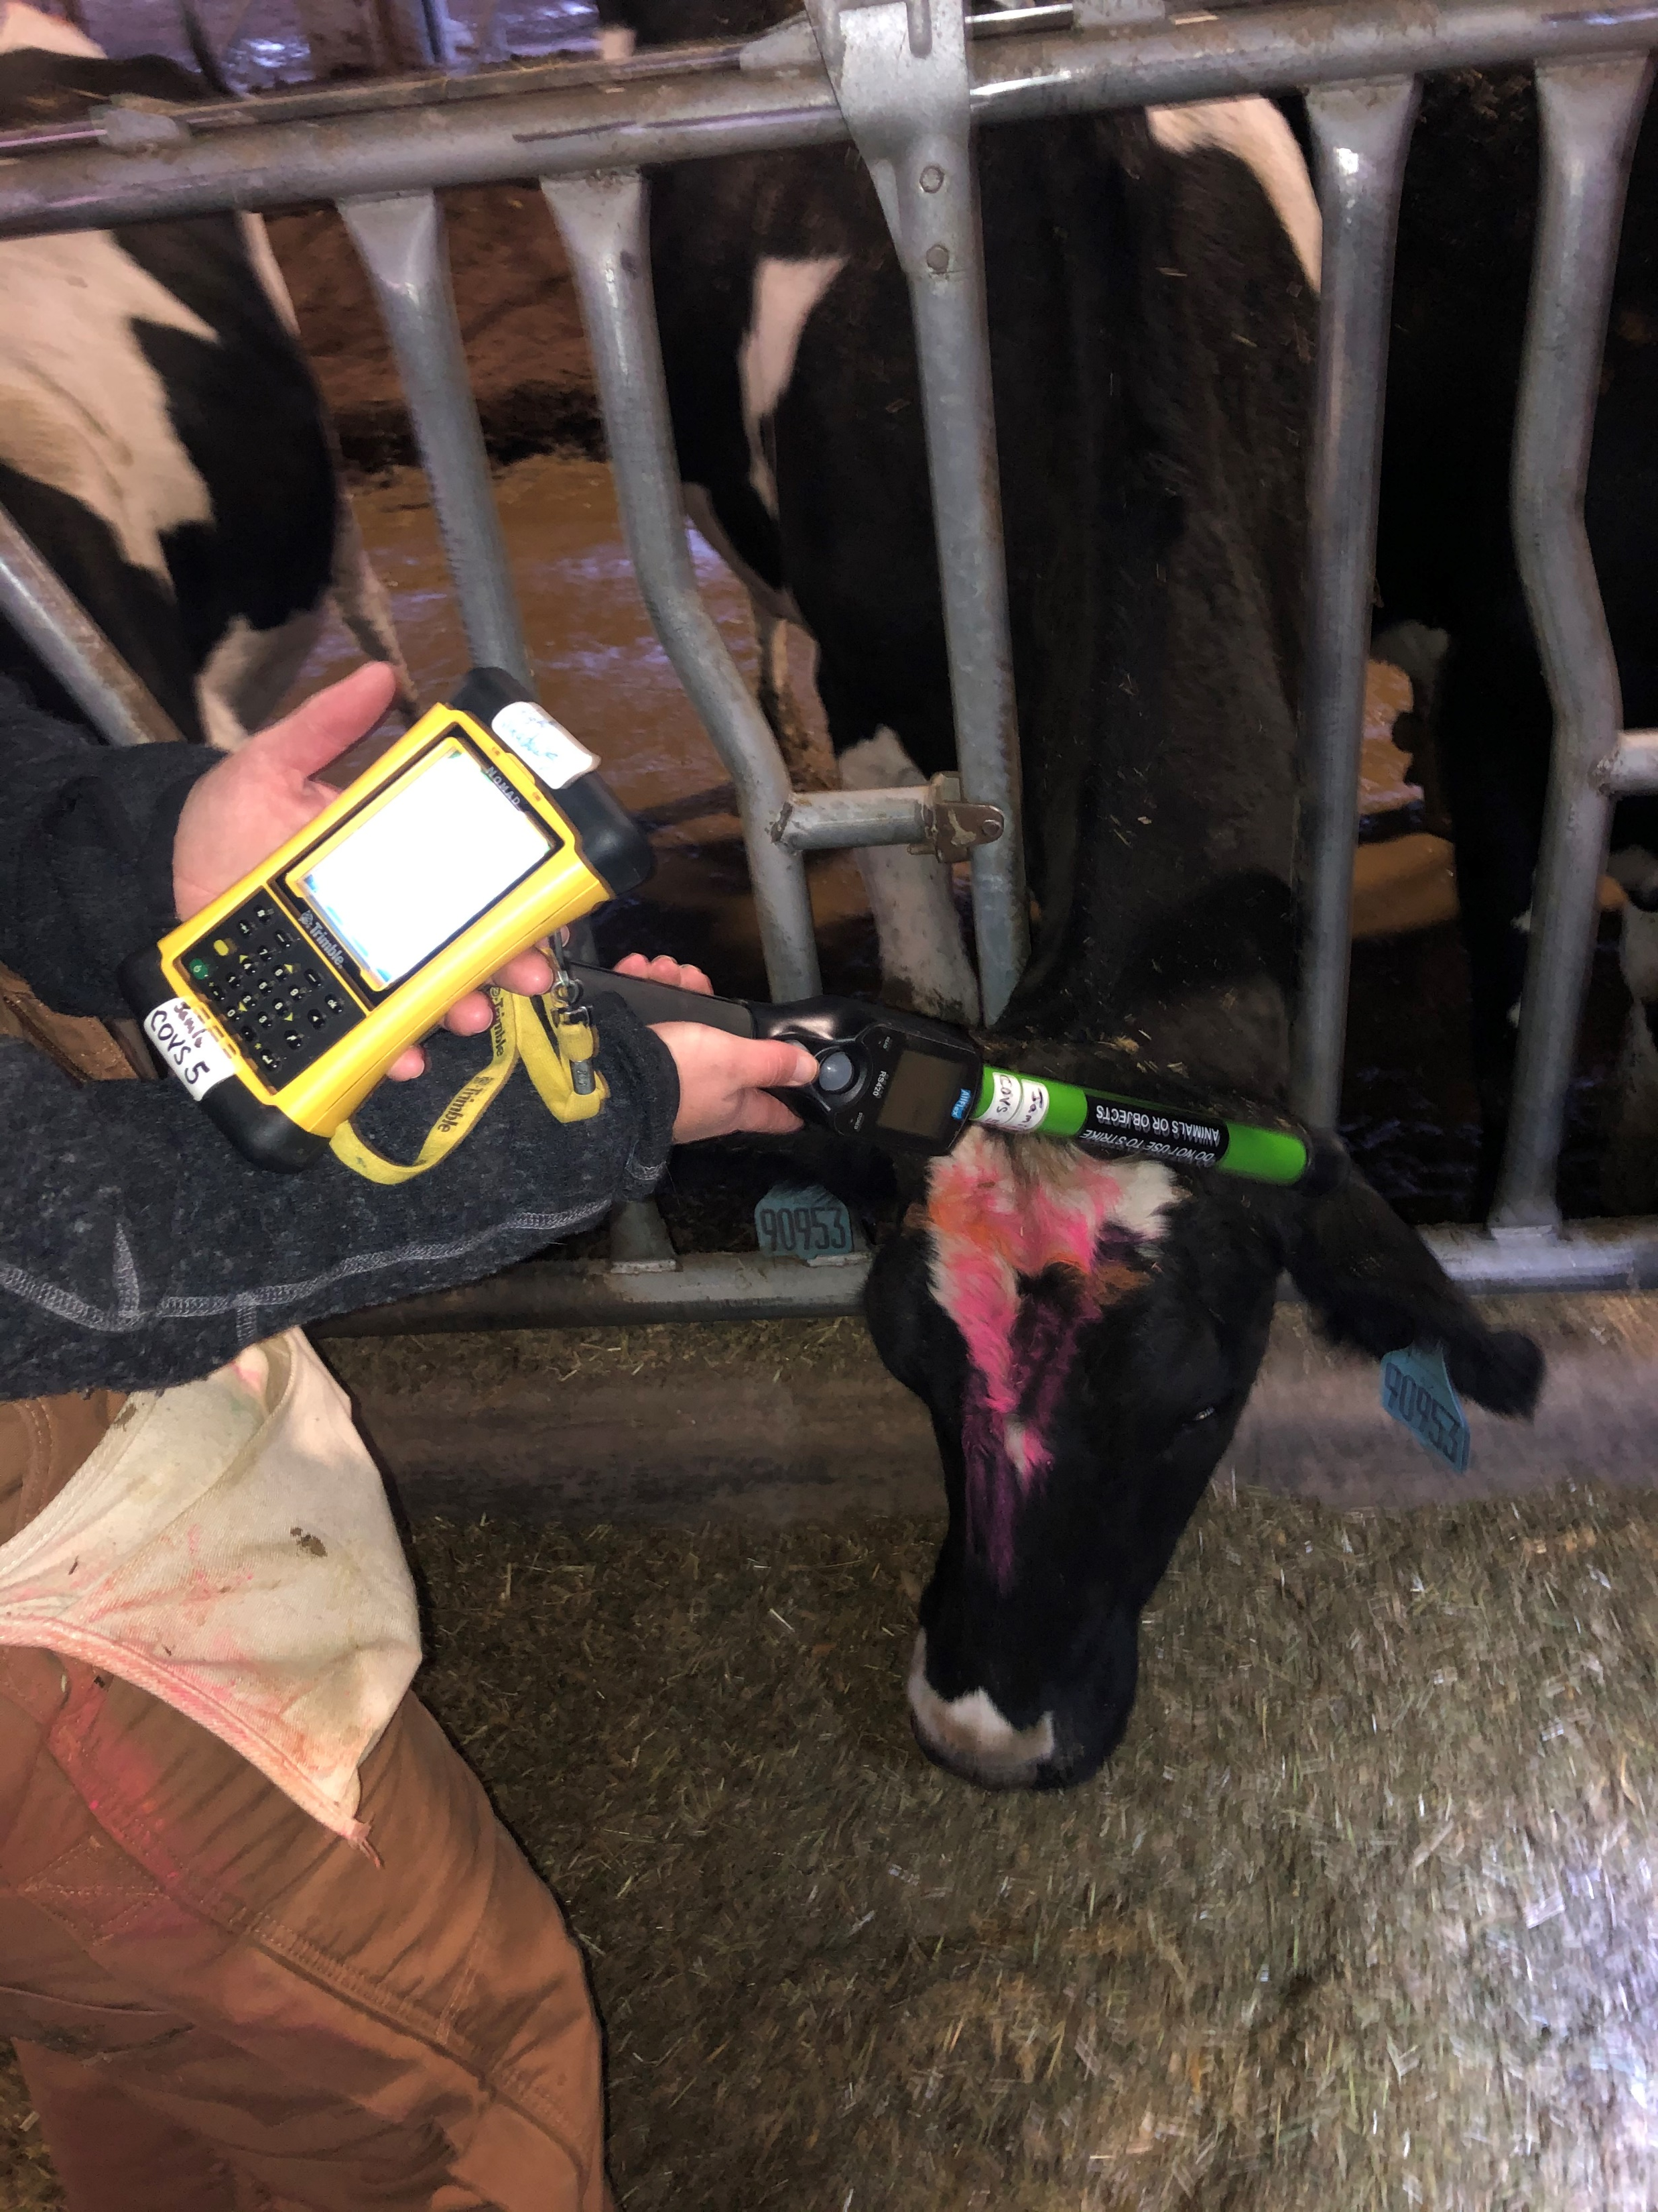
Infrastructure
We require the ear tags for regulatory use
We want to make them easier to read for those that “need” to read them
Strategically support the placement and purchases of readers
  For slaughter plants
  For Accredited Vets
  For livestock markets
  Others?

Slide 12
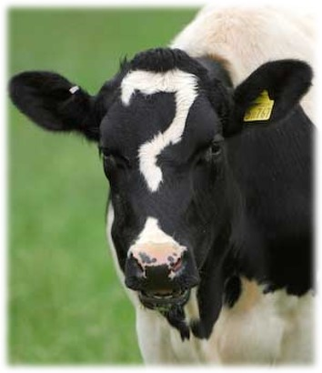
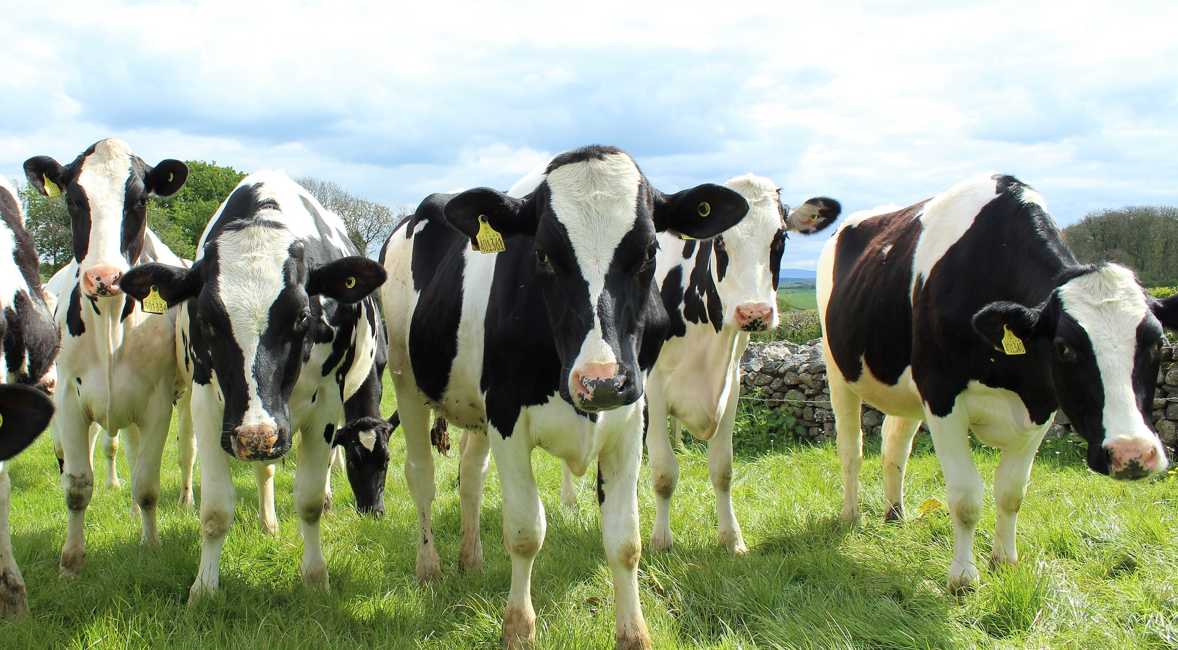
Questions?
traceability@usda.gov

