Slide 1
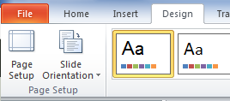
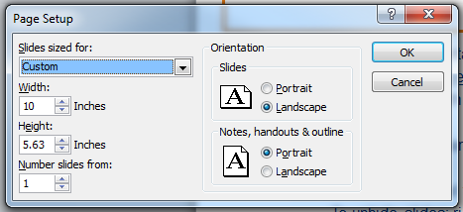

How to use this slide deck
What to do if the presentation looks “squished”:
  Changing the aspect ratio of the slides: “Design” tab → “Page Setup” → change width to 10in. and height to 5.63in
Delete or hide any unwanted/irrelevant slides
Use the hidden slides at the end of the presentation as templates for adding additional content
  To unhide slides: right click desired slide → click “hide slide” at bottom of window to unhide the slide
Copy and paste icons from the hidden “Icons” slide onto new slides (optional)
  Resize icons by holding down the shift key then dragging the corner of the icon to the desired size
Notes:
3 point slide

Slide 2
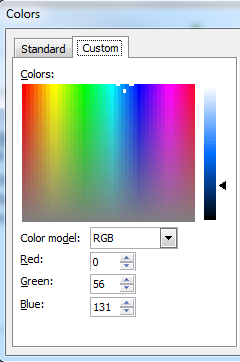
How to use this slide deck - Text
Font: Arial
Text color:
  Slide content:
    Navy blue: (R=0, G=56, B=131)
  Headings:
    Orange: (R=238, G=125, B=17)
    Bold all headings
  Change text color: highlight desired text → text color dropdown arrow → “More colors” →”Custom” tab → add in the RGB code into text boxes
Use bulleted points instead of paragraphs of text.
  Use the bullets as the points you want to make and prompts of subjects you want to cover during the slide.
  Explanations can be said during presentation instead of shown on the slide text.
Notes:
3 point slide

Slide 3

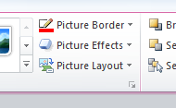
How to use this slide deck – Photos
When photos are added to slides, an added boarder is encouraged. Colors for boarders are:
  Navy: R=0, G=56, B=131
  Orange: R=238, G=125, B=17
  Light Blue: R=109, G=147, B=189
Adding boarders to photos:
  Select photo → “Picture Tools Format” (on the above ribbon) → “Picture Boarder” dropdown → weight → 2¼ pt. line
Change photo boarder color:
  Select photo → “Picture Tools Format” → “More Outline Colors” → “Custom” tab → add in the RGB code (shown above) into text boxes
Notes:
3 point slide

Slide 4
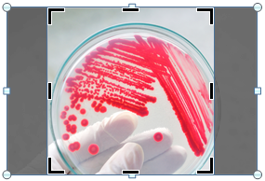
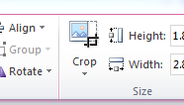
How to use this slide deck – Photos continued
Resizing photos:
  Select photo → hold down shift key → drag corner of photo to desired size while holding down shift key
Reshaping a photo as a circle:
  Select photo → “Picture Tools Format” → “Crop” dropdown arrow on ribbon → “Aspect ratio” → 1:1 → drag & adjust picture into square frame → resize square frame while holding down shift & dragging photo corner → click off of photo, then re-select → on “Picture Tools Format”, “crop” dropdown arrow → crop as shape → select circle
Adjust zoom in on photo within square frame by holding shift key & dragging circle photo corner
Adjust square frame size by holding shift key & dragging black corner to desired size
Notes:
3 point slide

Slide 5




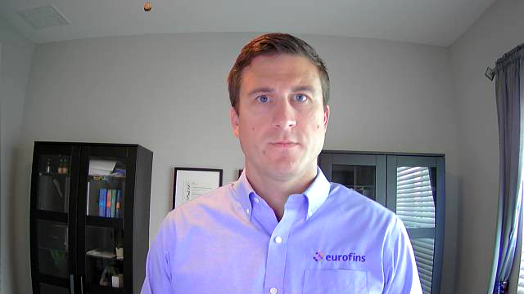
Dino D. Holmquist,
MSc, PhD
Eurofins DQCI
Notes:
General Eurofins Intro Slide
- May change the top right circle image to industry specific picture. Industry-specific circle images can be taken from the industry testing services slides from later in this presentation.

Slide 6

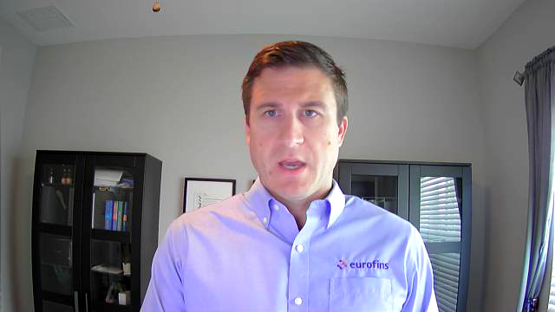
Sample ID & Lab flow
Current and future business decisions
Notes:
introduction to myself, and Eurofins DQCI

Slide 7
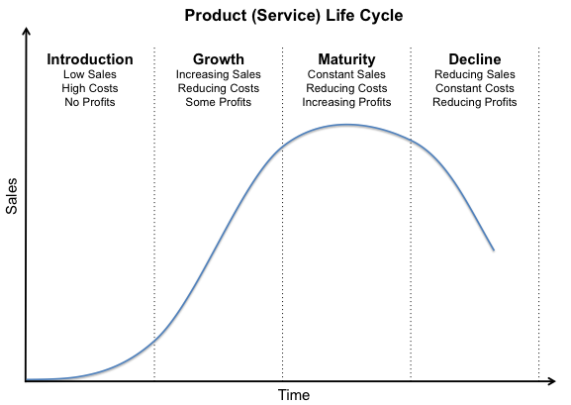


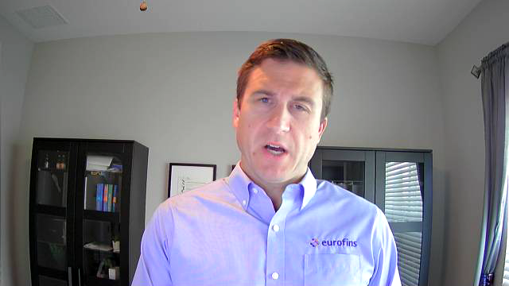
Notes:
Business model: Why do some services survive, and others don’t.

Slide 8
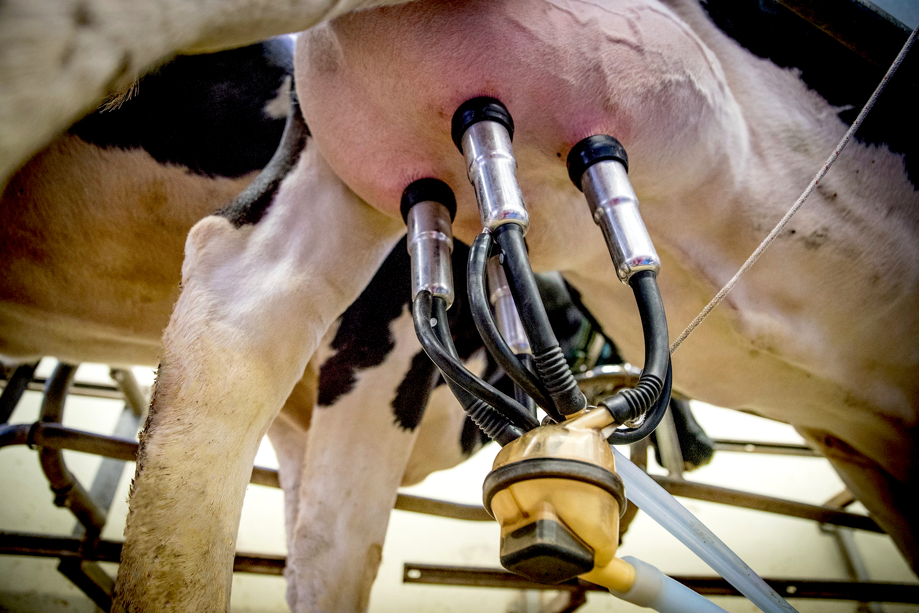
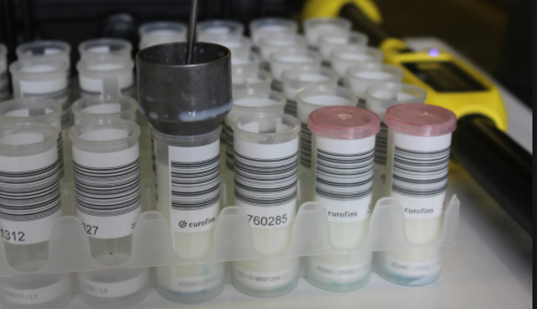
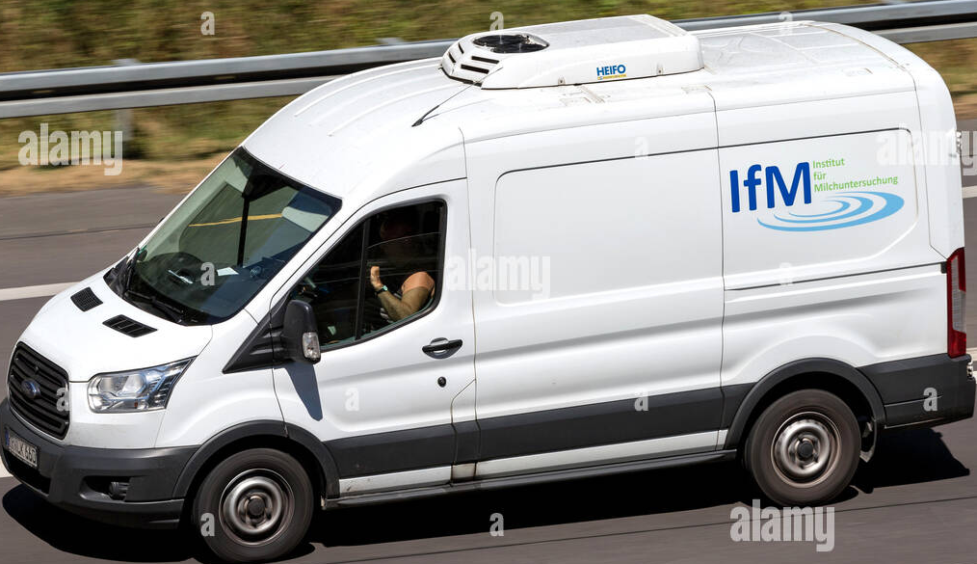
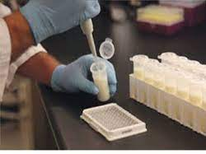
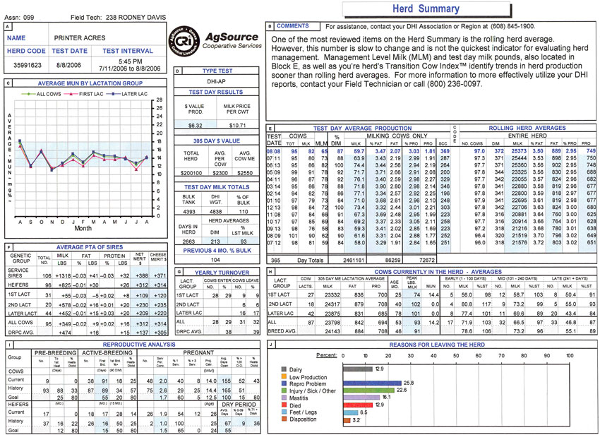
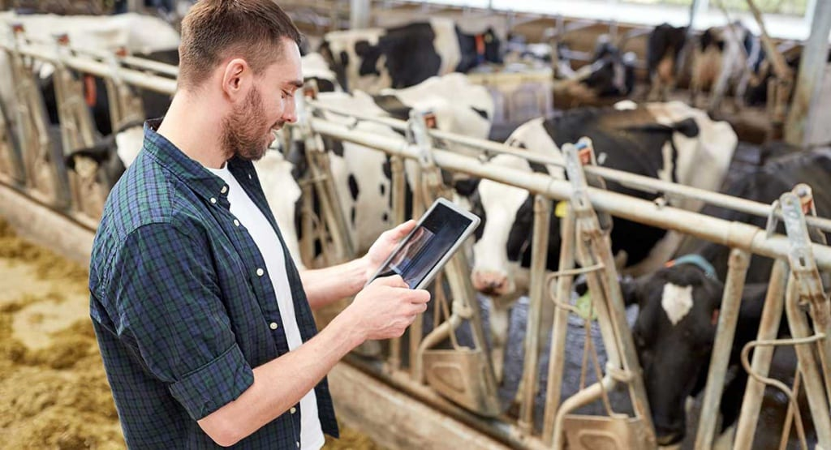
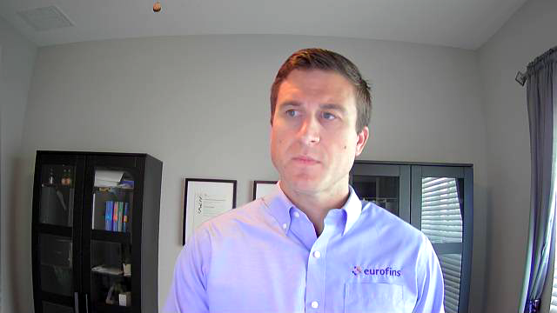
DHIA: From sample to information
Traceability
Notes:
Traceability is the key, when data is the key business model.

Slide 9
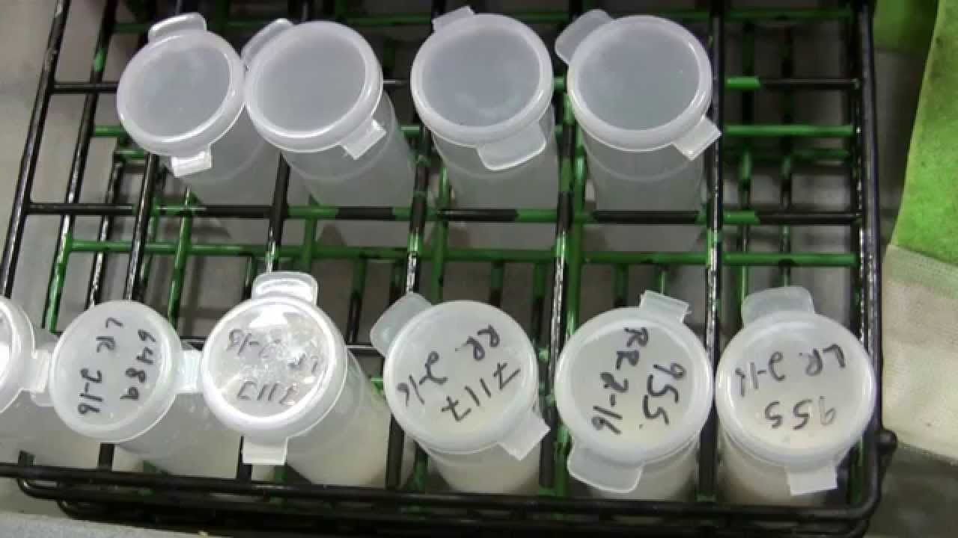
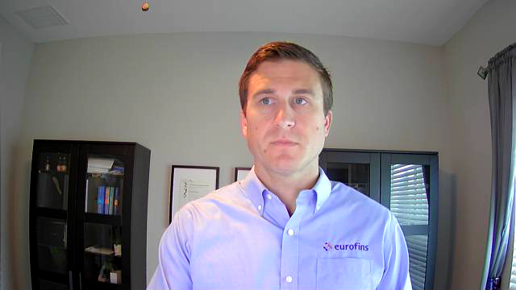
There are champions in each category...
Notes:
3 point slide

Slide 10
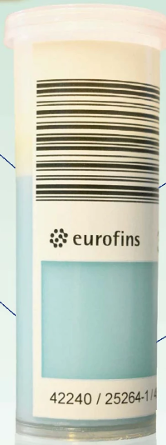

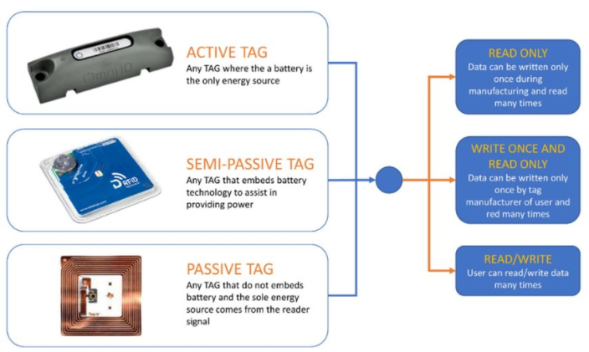
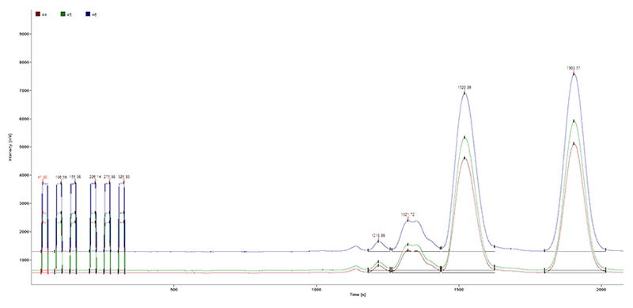
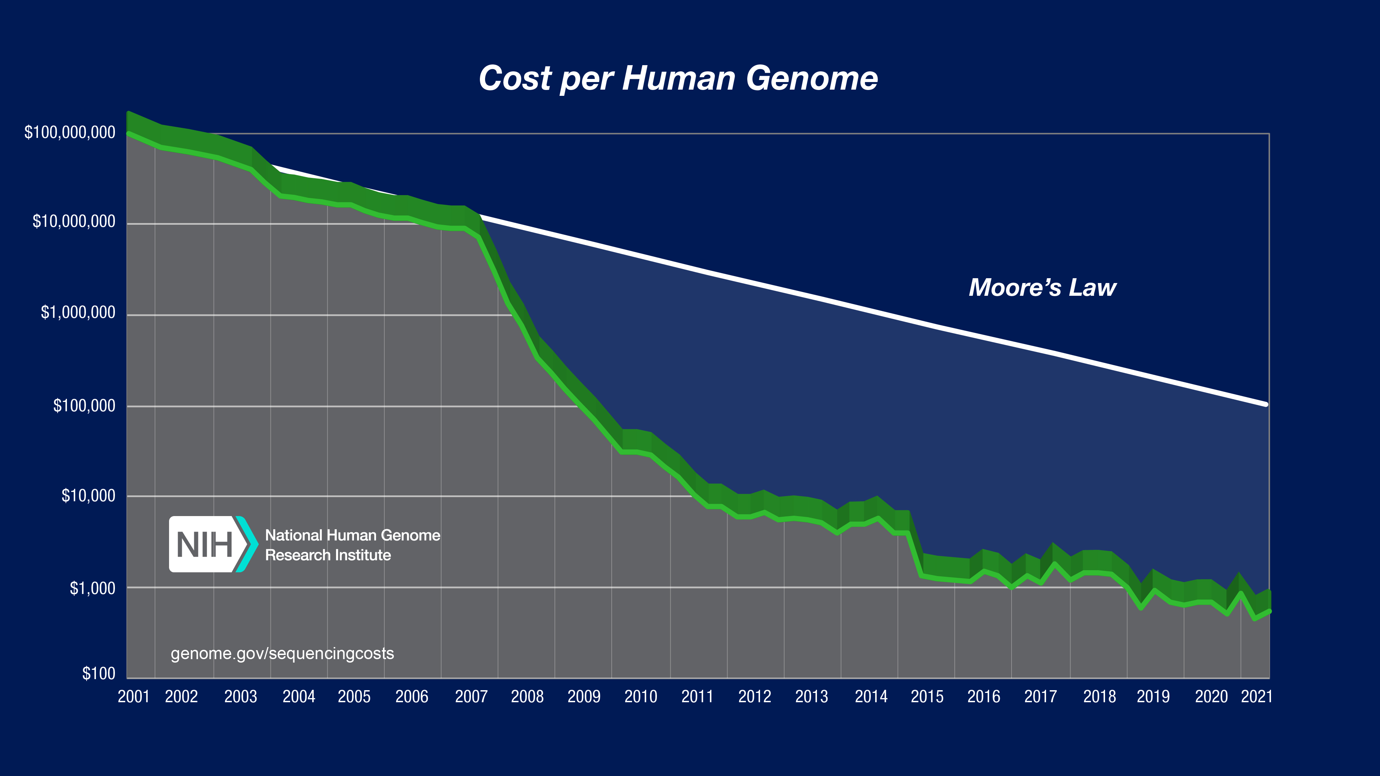
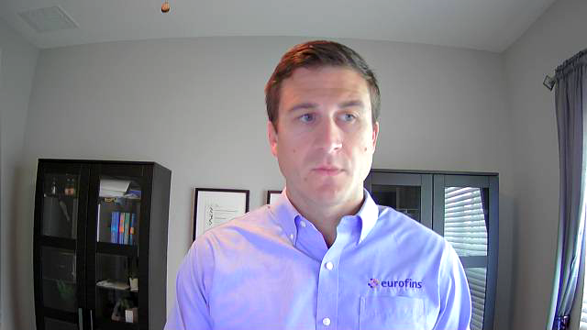
Future of traceability
Notes:
In the future, it will not be enough having machine-read samples; unique samples fingerprinting will be the new standard.

Slide 11
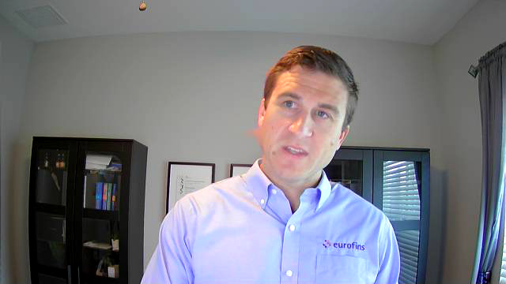
Challenges on flexibility
Once a month testing
All or nothing
Lack of specific testing
Sample transportation
Applicability of information
Notes:
3 point slide

Slide 12
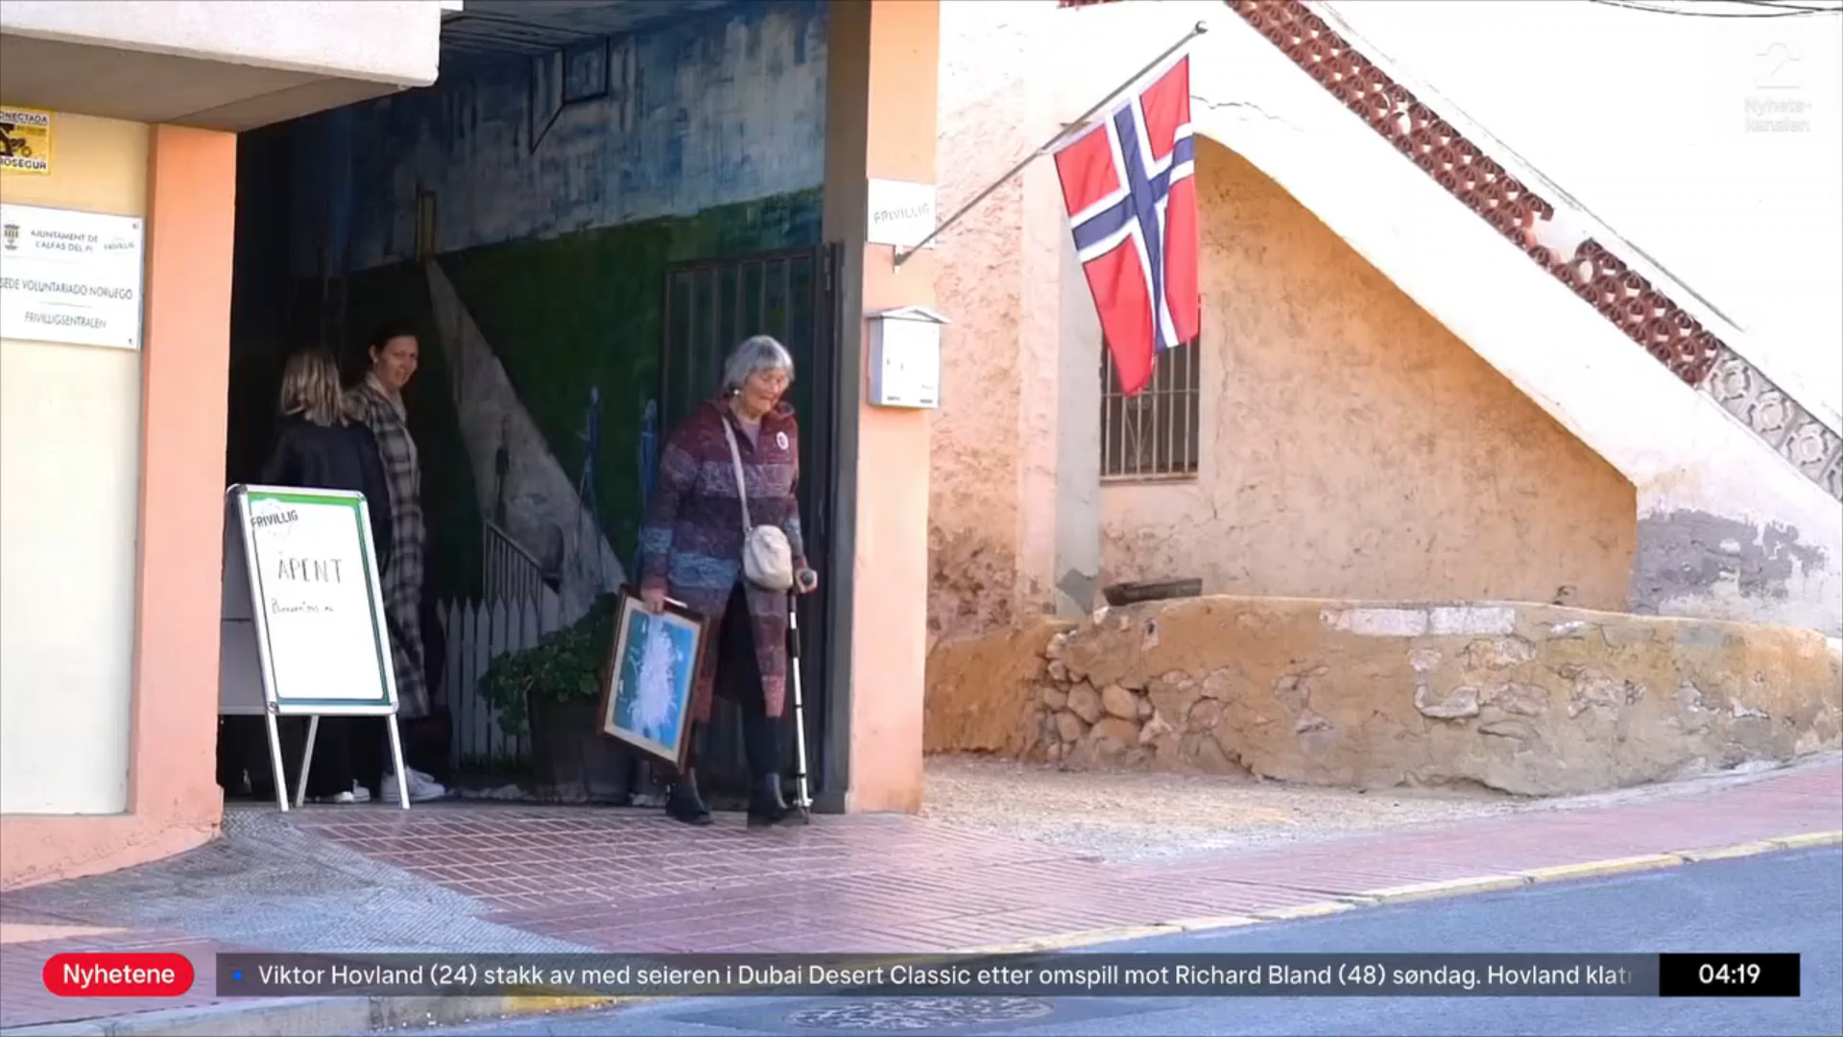
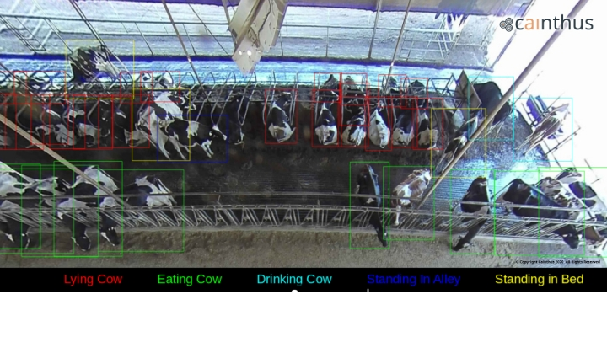
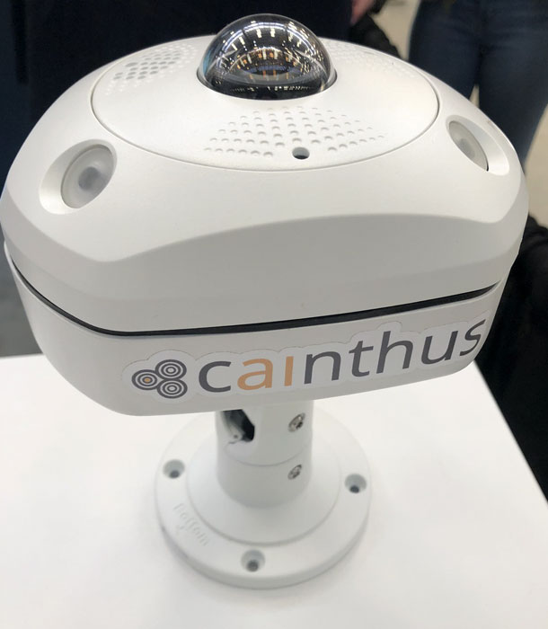
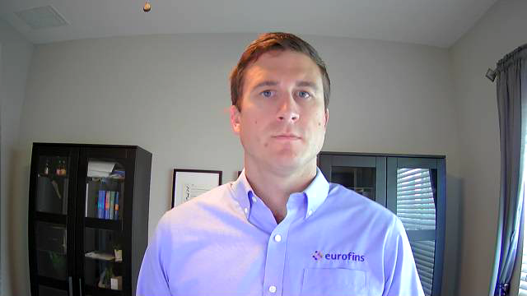
Future of smart farming...
Predictive analytics
Testing on demand

Slide 13
Thank You!
Notes:
Collaboration is key. Nobody can grasp it all by themselves. I would like to take the opportunity to invite whoever is interested to grow this

Slide 14



































Icons
These icons can be used to replace others throughout the presentation slides.

